Slide 1
Detection of Schizophrenia using Machine Learning
Team: CSE_I_27
Deeksha Madan 02814802718
Deepika Rana 03214802718
Harshita Chadha 35314802718
Project Guide: Dr. Neelam Sharma

Slide 2
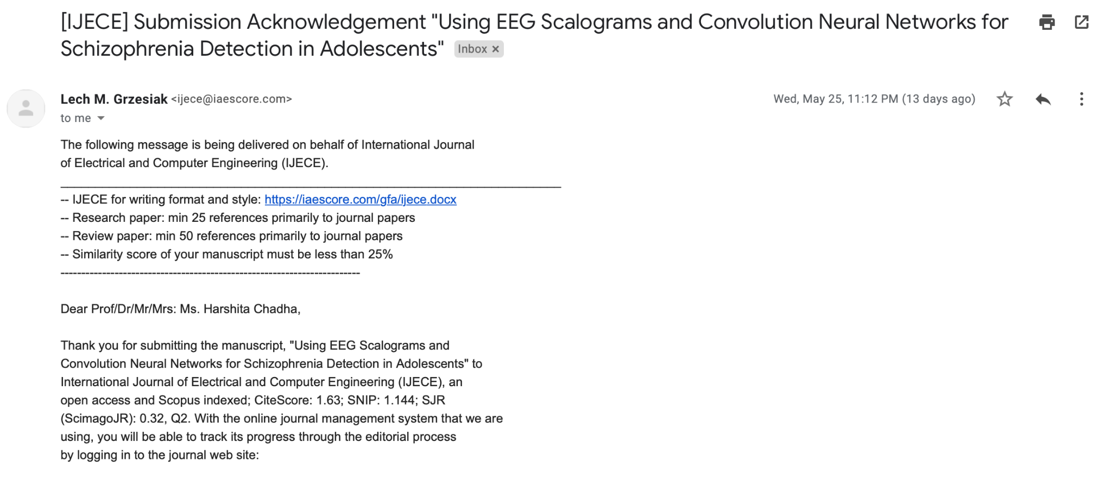
Research Paper Details
Title: Using EEG Scalograms and Convolution Neural Networks for Schizophrenia Detection in Adolescents
Authors: Dr. Neelam Sharma, Harshita Chadha, Deeksha Madan, Deepika Rana
Journal: International Journal of Electrical and Computer Engineering (IJECE) (Scopus - ESCI Indexed)
Current Status: Under Review

Slide 3
Problem Statement
Studying existing solutions based on different techniques (sMRI, fMRI, EEG) with adolescent data points to facilitate early detection.
Converting the raw EEG signals to a well defined dataset using Continuous Wavelet Transform technique.
Proposing a novel methodology using Convolution Neural Network (CNN) that outperforms existing solutions based on previous metric study.

Slide 4
Abstract
Schizophrenia is a serious mental illness that interferes with a person’s ability to think clearly, manage emotions, make decisions and relate to others.
This project proposes a convolution neural network-based schizophrenia detection technique that makes use of biomedical signals to classify patient groups.
The use of electroencephalogram (EEG) data from an adolescent control group is done to tailor the model to facilitate accurate early detection.
To prepare the EEG impulses, the Morlet Wavelet Transform is used to obtain RGB scalograms in image format. These are fed into the 7 layers deep CNN. In the end, the model is shown to have F1 score of 0.945.

Slide 5
INTRODUCTION
Scope
Accurate + Cost-friendly detection of Schizophrenia
at an early stage
Treatment is much more effective if Schizophrenia is detected early. Initial signs are very subtle and can’t be detected by humans
Motivation
Challenges
Present research and datasets focused on Adult patients
Current models use fMRI heavily

Slide 6
Objectives
To use Electroencephalography (EEG) neuroimaging technique to diagnose Schizophrenia in patients in comparison to fMRI and sMRI techniques.
To create a model using Deep Learning which outperforms existing techniques and is more optimised.
To do a performance evaluation of proposed model based on the different parameters which are:
Sensitivity
Specificity
F1-score
Accuracy
Negative predictive value
Positive predictive value

Slide 7
Research Gaps
Method to extract useful features and then feeding into the classifier for standard class mapping operations has lot of human intervention required and the computational complexity involved.
ScalNet 7 model make uses Morlet Wavelets and Convolution Neural Networks for creating a deep learning classification pipeline.
All model specifications are chosen so as to limit the time and computation complexity of the detection operation.

Slide 8
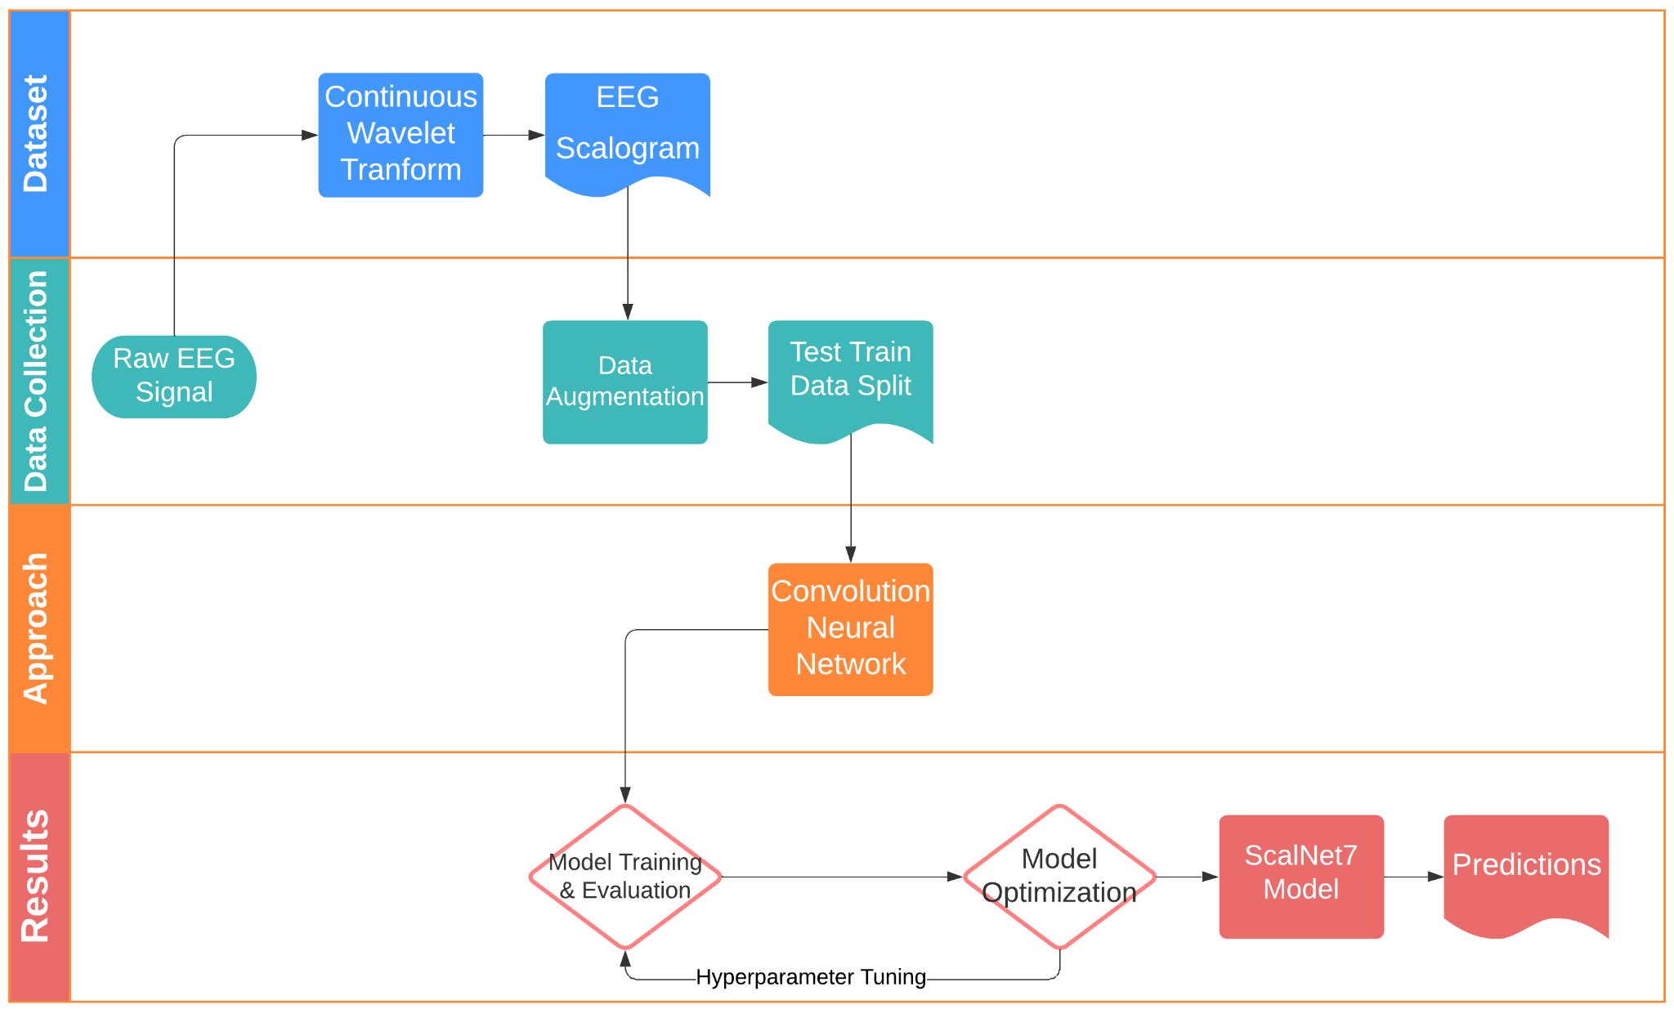
Data Flow Diagram

Slide 9
Technology Stack
Python
01
For signal processing.
Tensorflow + Keras
02
ML Models
Google Colab
03
Modelling Approach
Visualisation Libraries
04
Numpy, Pandas, Matplotlib

Slide 10
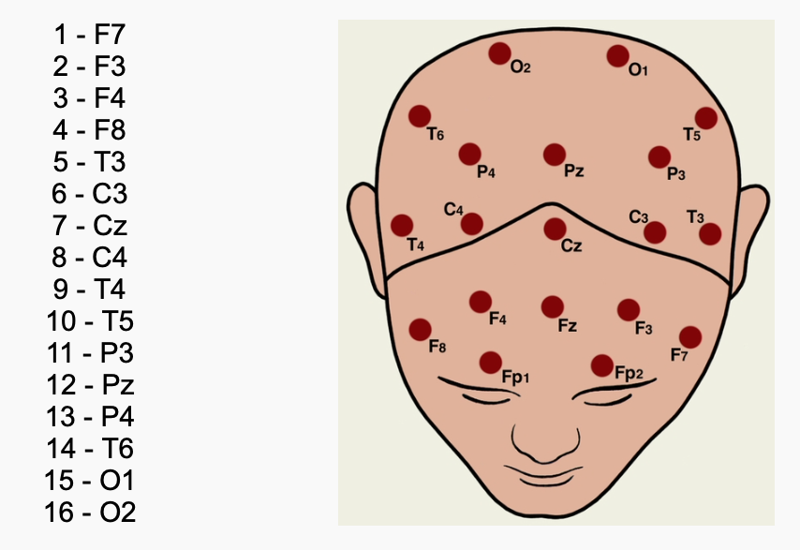
DATASET USED
For the present project’s purpose, the EEG data used was obtained from an archive of the Faculty of Biology, M.V. Lomonosov Moscow State University.
There are two EEG data archives for two groups of subjects.
The subjects were adolescents who had been screened by a psychiatrist and divided into two groups: healthy (n = 39) and with symptoms of schizophrenia (n = 45).
EEG records from each of the 16 channels were obtained. The topographical positions of channel numbers are shown in figure

Slide 11
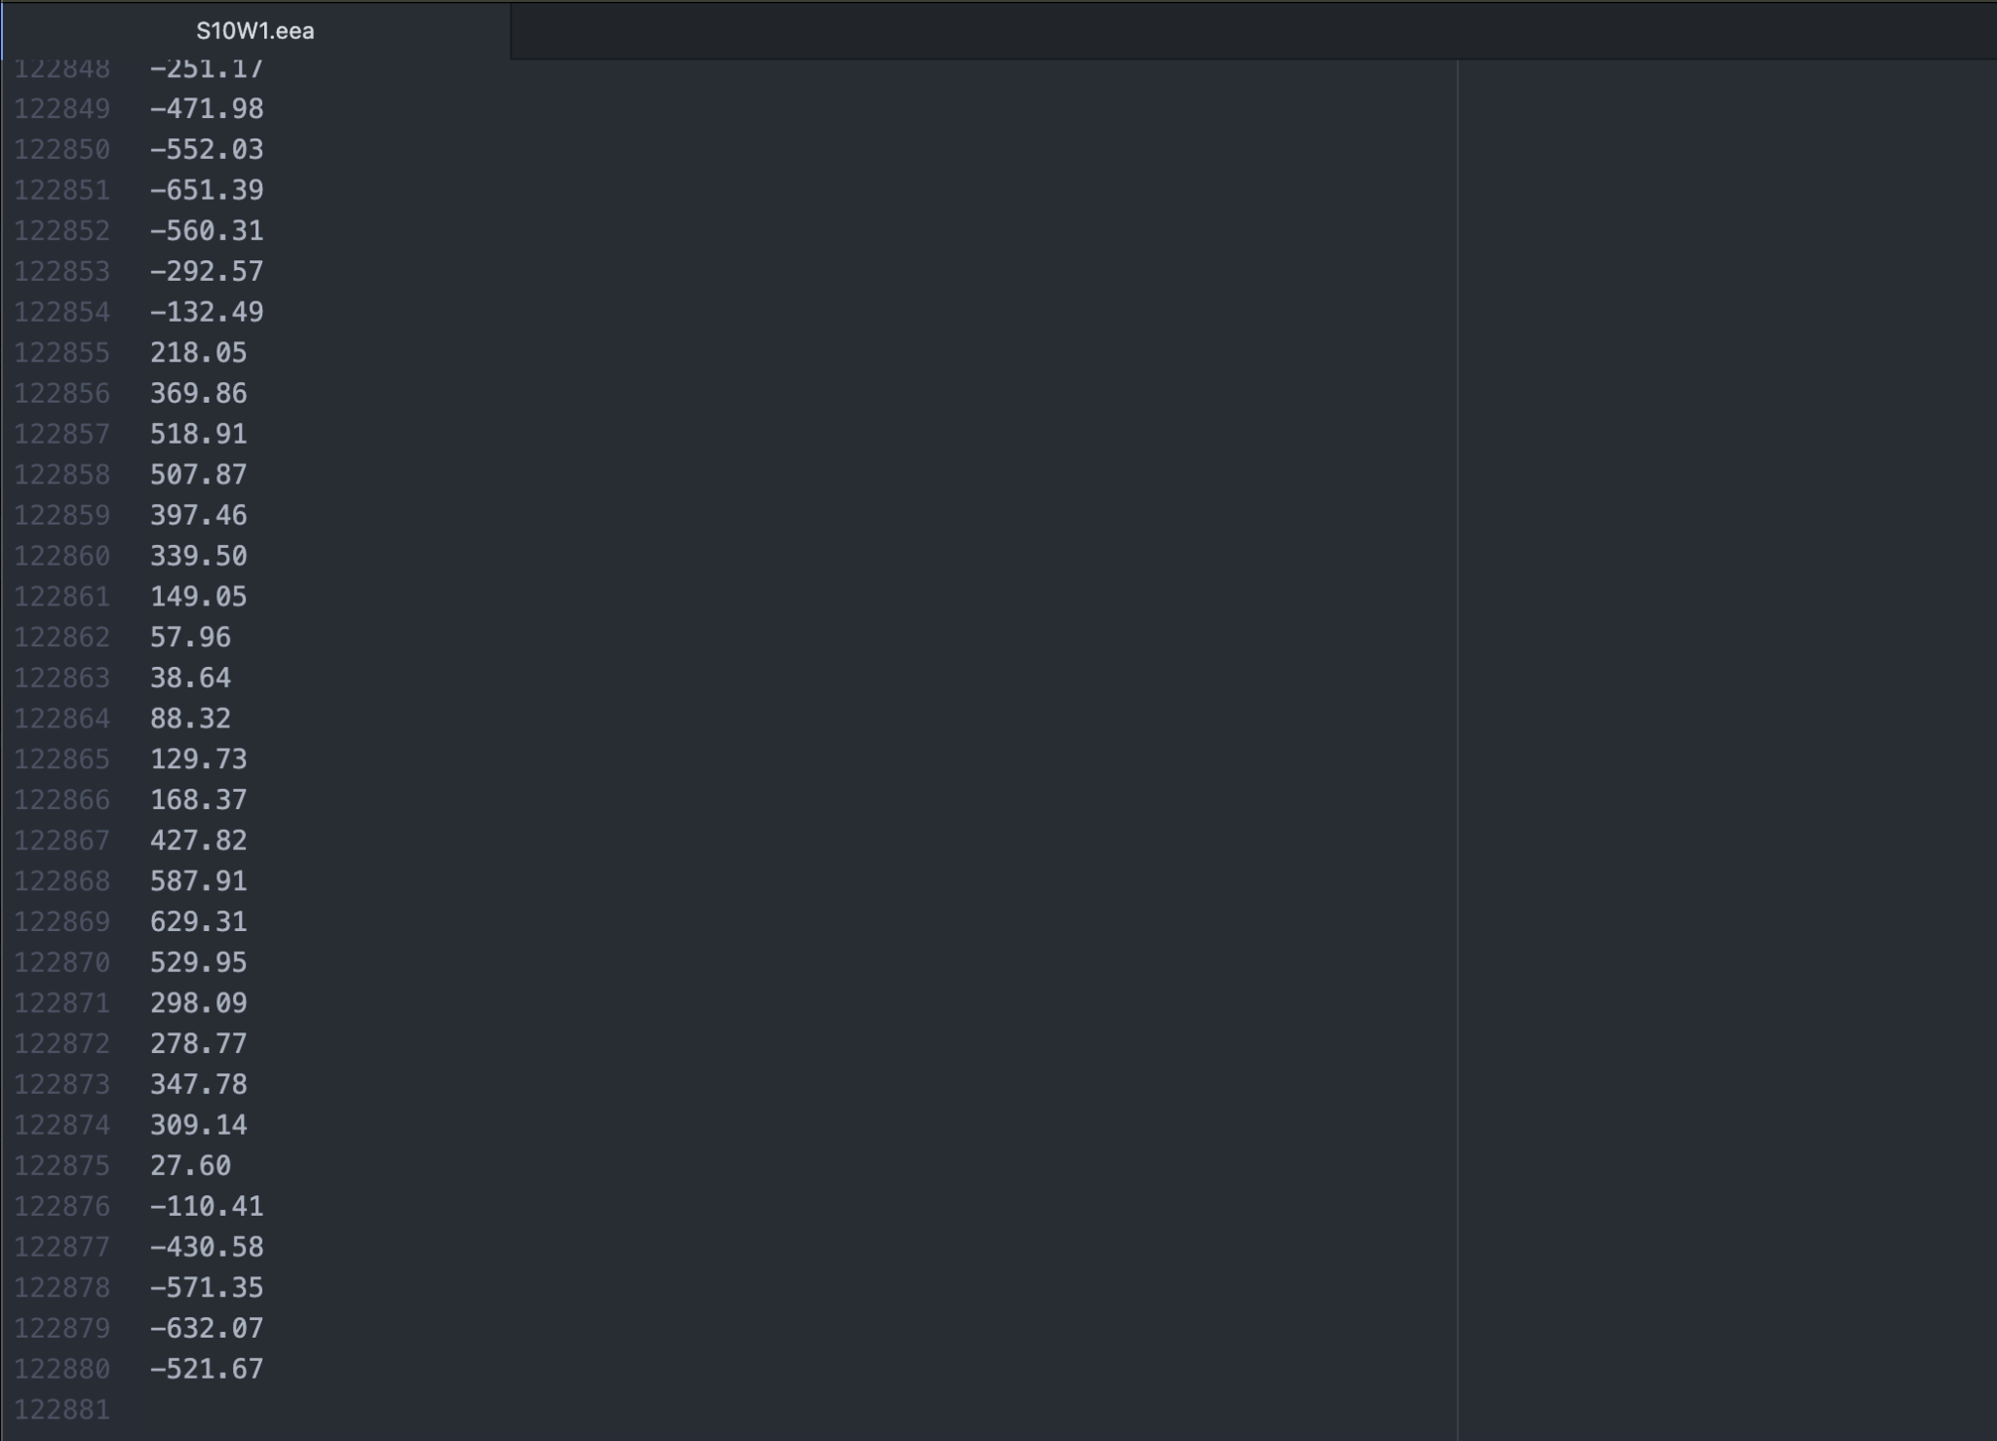
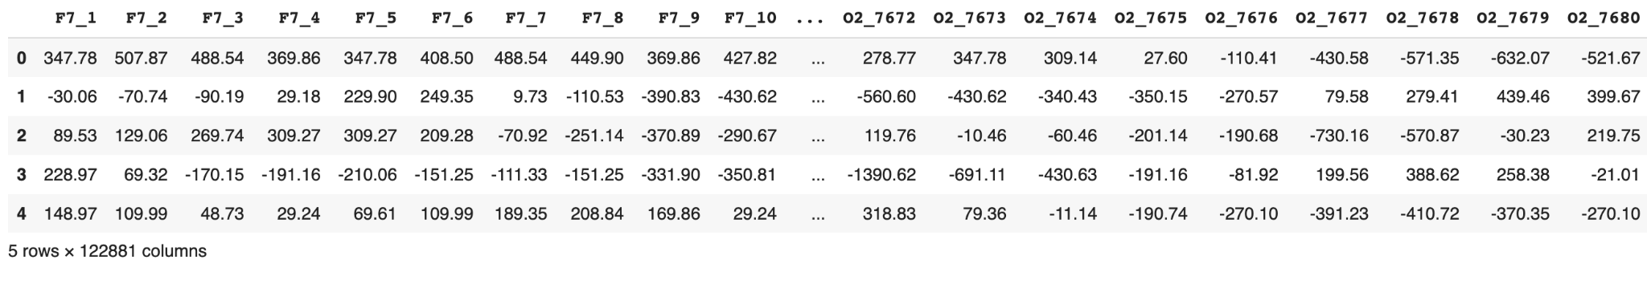
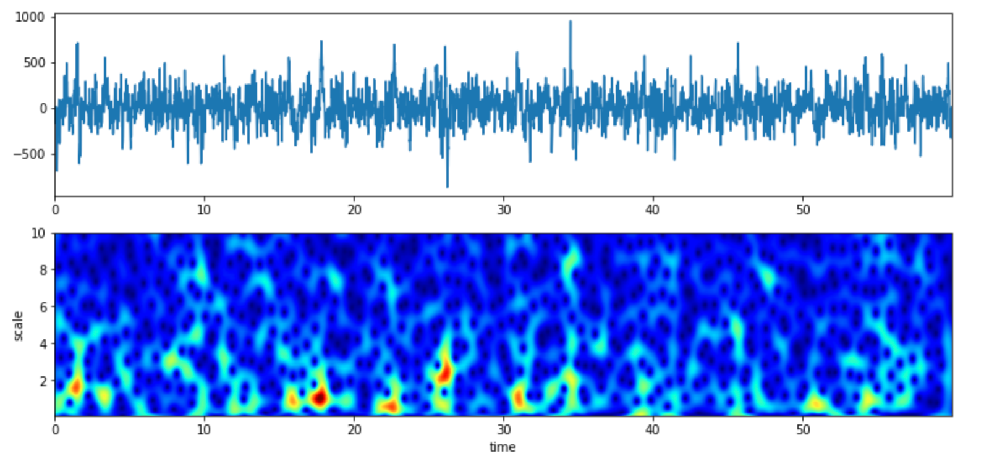

Slide 12
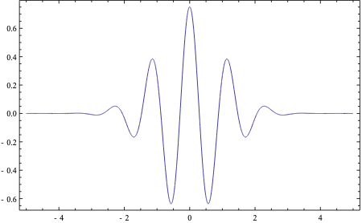
Frequency
Frequency
Frequency
Time
Time
Time
Time Series
Fourier Transform
Spectrogram
Frequency
Morlet Wavelet
Time
Wavelet Analysis

Slide 13
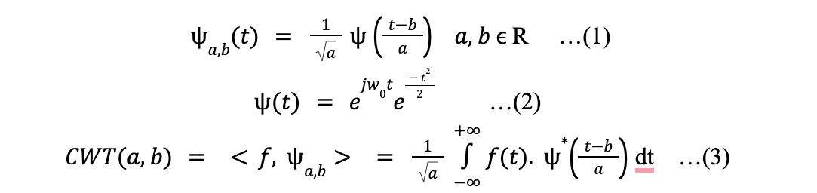
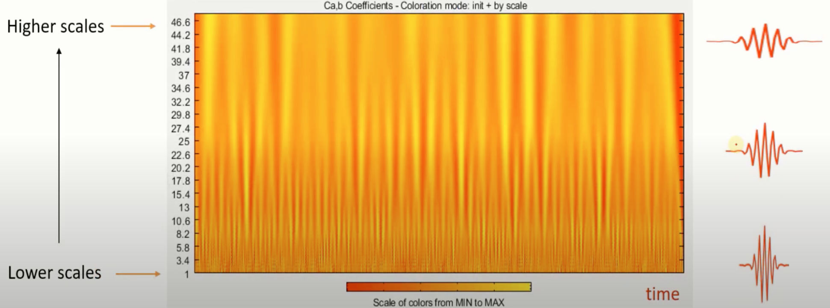

Slide 14
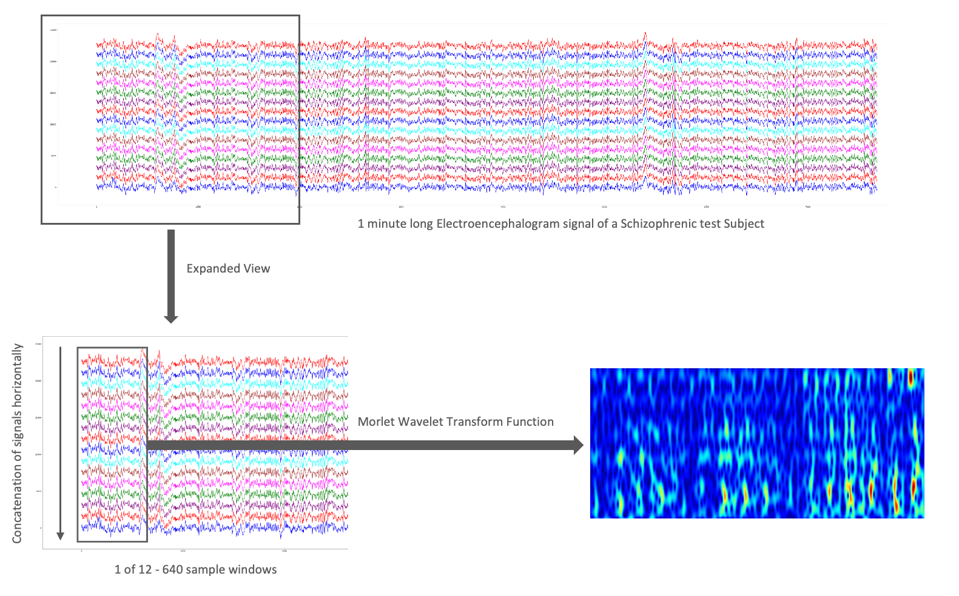
Proposed model
The proposed model is titled ScalNet7 and it is a 7 layer deep convolution neural network.
Scalograms are prepared using Morlet wavelet transform.
For each test subject, 640 samples per each electrodes are combined to get a single scalogram.
Input : Scalograms of EEG signals
Output : Class probability prediction.

Slide 15
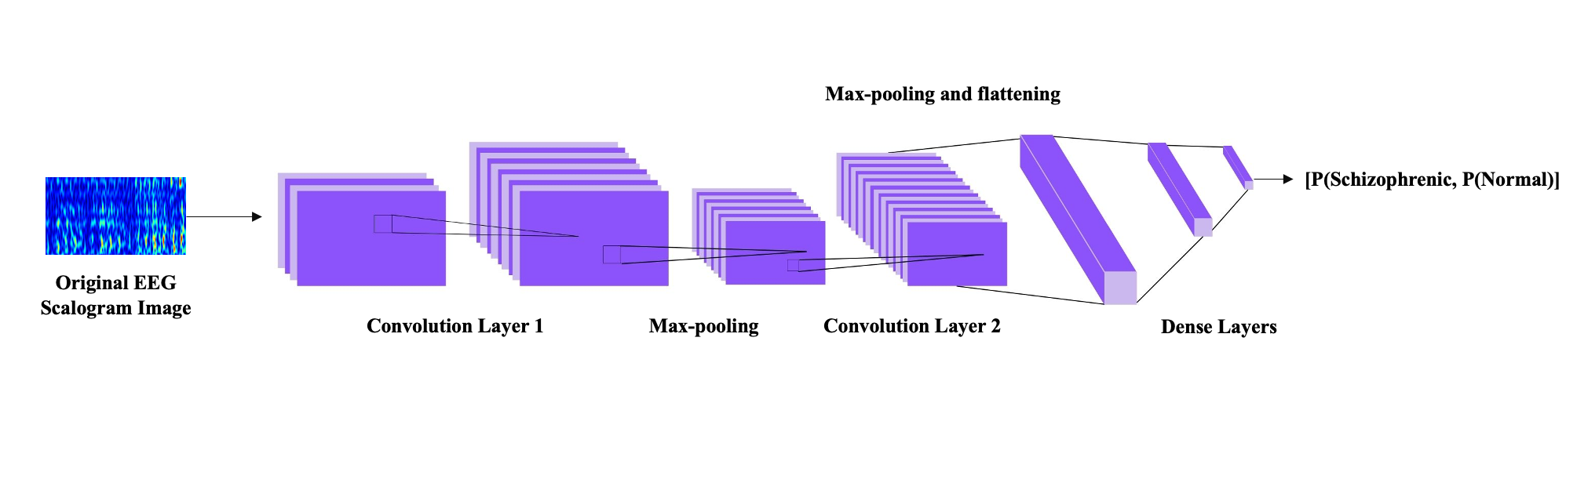
The ScalNet7 Model
7 Layers in Total
2 Max-pooling layers of
2 Convolution layers of kernel size 3X3
One flattening layer and 2 dense layers with Re-Lu and softmax activations respectively

Slide 16


Slide 17
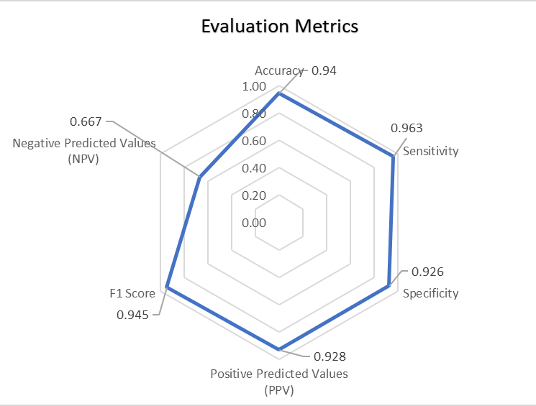
RESULTS
Parameter | Value
Accuracy | 94.44%
Sensitivity | 0.963
Specificity | 0.926
Positive Predicted Values (PPV) | 0.928
F1 Score | 0.945
Negative Predicted Values (NPV) | 0.667

Slide 18
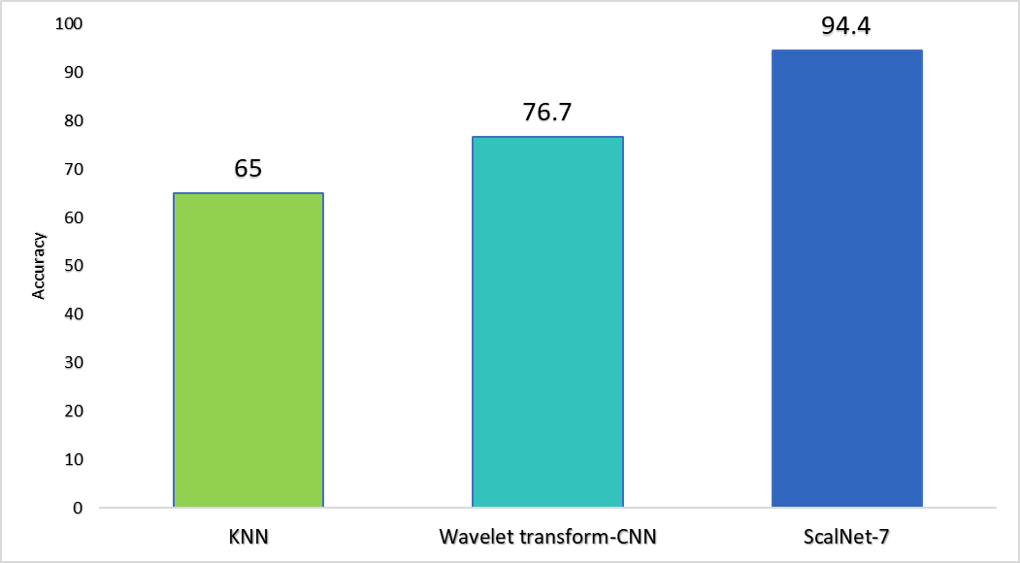
Comparison between our models

Slide 19
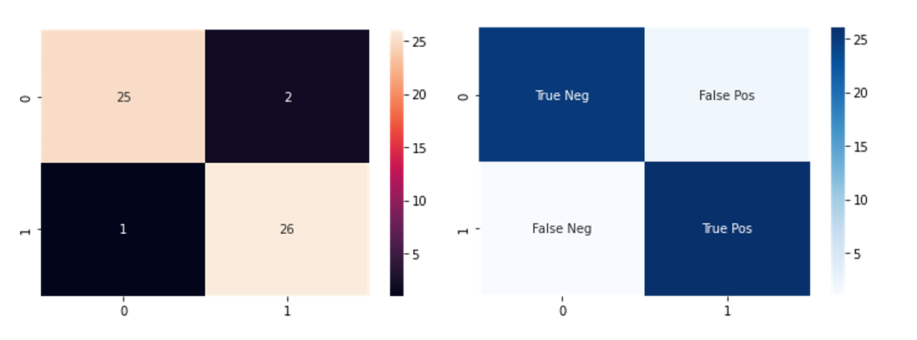
Confusion Matrix
True Negative | 25
False Negative | 1
True Positive | 26
False Positive | 2

Slide 20
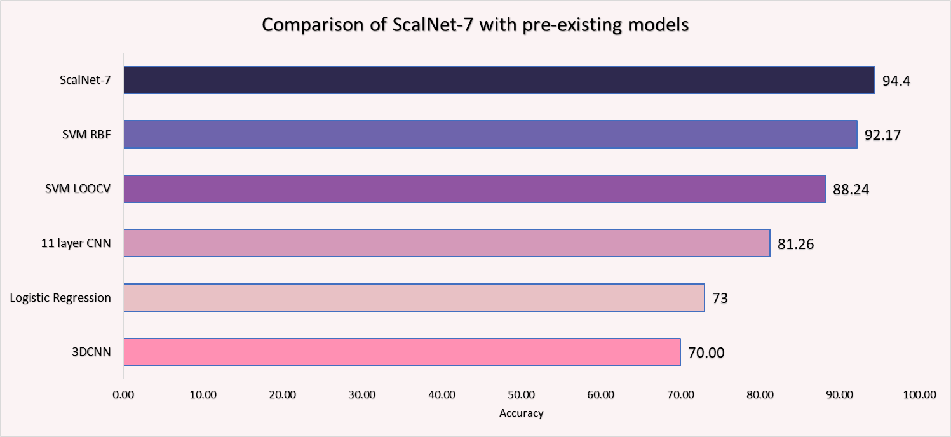
Comparison with existing solution

Slide 21
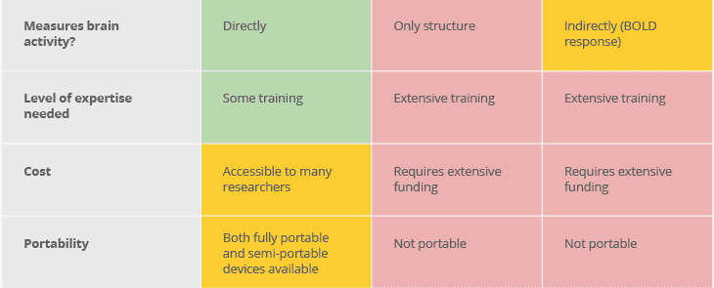
Feasibility Study for Engineering Significance
Need: Help diagnose people who may seem healthy now but are at a risk of developing mental health diseases at a later stage.
EEG
MRI
fMRI
Electroencephalogram
Magnetic Resonance Imaging
Functional MRI

Slide 22
Conclusion
Project Conclusions
Our study was focused on utilizing data from adolescent test subjects so as to work towards bridging the gap that exists in the early detection of this disease
The presented model uses convolution neural networks and Morlet wavelet analysis for the detection of schizophrenia using EEG scalograms. The model converged at a training accuracy of 100% and testing accuracy of 94.4%.
The lightweight framework and computationally inexpensive nature of the model also make it highly feasible for field implementation.
Future Scope
In the future, the performance of the model can be enhanced by making the model deeper and training on a more expansive, balanced and inclusive dataset. Further, efforts to enhance the negative predicted value (NPV) parameter may also be made.

Slide 23
Thank You!
Team: CSE_I_27
Deeksha Madan 02814802718
Deepika Rana 03214802718
Harshita Chadha 35314802718
Project Guide: Dr. Neelam Sharma

Slide 24
References
[1] What is schizophrenia? Psychiatry.org - What is Schizophrenia? (n.d.). Retrieved May 10, 2022, from https://psychiatry.org/patients-families/schizophrenia/what-is-schizophrenia
[2] What is Schizophrenia? | NAMI: National Alliance on Mental Illness. (n.d.). National Alliance on Mental Illness (NAMI).
[3] NHS. (n.d.). Diagnosis - Schizophrenia. NHS choices. Retrieved May 10, 2022.2020
[4] Cortes-Briones, J. A., Tapia-Rivas, N. I., D’Souza, D. C., & Estevez, P. A. (2021). Going deep into schizophrenia with artificial intelligence. Schizophrenia Research.
[5] Singh Suri, G., Kaur, G., & Moein, S. (2021). Machine Learning in Detecting Schizophrenia: An Overview. Intelligent Automation & Soft Computing, 27(3), 723–735. https://doi.org/10.32604/iasc.2021.015049
[6] Oh, J., Oh, B. L., Lee, K. U., Chae, J. H., & Yun, K. (2020). Identifying Schizophrenia Using Structural MRI With a Deep Learning Algorithm. Frontiers in Psychiatry, 11. https://doi.org/10.3389/fpsyt..00016
[7] Cabral, C., Ilankovic, L. K., Kambeitz, J., Calhoun, V. D., Dwyer, D. B., Saldern, S., Urquijo, M. F., Falkai, P., Koutsouleris, N. (2016). Classifying Schizophrenia Using Multimodal Multivariate Pattern Recognition Analysis: Evaluating the Impact of Individual Clinical Profiles on the Neurodiagnostic Performance. Schizophrenia Bulletin, Volume 42(1), July 2016, S110–S117. https://doi.org/10.1093/schbul/sbw053
[8] Shi, D., Li, Y., Zhang, H., Yao, X., Wang, S., Wang, G., Ren, K. (2021). Machine Learning of Schizophrenia Detection with Structural and Functional Neuroimaging. Disease Markers, vol. 2021, Article ID 9963824, 12 pages, 2021. https://doi.org/10.1155/2021/9963824
[9] Sharma, G., Parashar, A., Joshi, A. M. (2021). DepHNN: A novel hybrid neural network for electroencephalogram (EEG)-based screening of depression. Biomedical Signal Processing and Control, Volume 66, 2021, 102393, 1746-8094. https://doi.org/10.1016/j.bspc.2020.102393
[10] Prasad, P. D., Halahalli, H. N., John, J. P., Majumdar, K. K. (2014). Single-Trial EEG Classification Using Logistic Regression Based on Ensemble Synchronization. IEEE J Biomed Health Inform. 2014 May;18(3):1074-80. https://doi.org/10.1109/jbhi.2013.2289741
[11] Shim, M., Hwang, H. J., Kim, D. W., Lee, S. H., Im, C. H. (2016). Machine-learning-based diagnosis of schizophrenia using combined sensor-level and source-level EEG features. Schizophrenia Research, Vol 176, Issues 2–3, 2016, 314-319, 0920-9964. https://doi.org/10.1016/j.schres.2016.05.007
[12] Prabhakar, S. K., Rajaguru, H., Kim, S. H. (2020). Schizophrenia EEG Signal Classification Based on Swarm Intelligence Computing. Computational Intelligence and Neuroscience, vol. 2020, 8853835. https://doi.org/10.1155/2020/8853835
[13] Ciprian, C., Masychev, K., Ravan, M., Manimaran, A., & Deshmukh, A. (2021). Diagnosing Schizophrenia Using Effective Connectivity of Resting-State EEG Data. Algorithms, 14(5), 139. https://doi.org/10.3390/a14050139

Slide 25
[15] Ahmedt-Aristizabal, D., Fernando, T., Denman, S., Robinson, J. E., Sridharan, S., Johnston, P. J., Laurens, K. R., & Fookes, C. (2021). Identification of Children at Risk of Schizophrenia via Deep Learning and EEG Responses. IEEE journal of biomedical and health informatics, 25(1), 69–76. https://doi.org/10.1109/JBHI.2020.2984238
[16] Shalbaf, A., Bagherzadeh, S., & Maghsoudi, A. (2020). Transfer learning with deep convolutional neural network for automated detection of schizophrenia from EEG signals. Physical and engineering sciences in medicine, 43(4), 1229–1239. https://doi.org/10.1007/s13246-020-00925-9
[17] de Filippis, R., Carbone, E. A., Gaetano, R., Bruni, A., Pugliese, V., Segura-Garcia, C., & De Fazio, P. (2019). Machine learning techniques in a structural and functional MRI diagnostic approach in schizophrenia: a systematic review. Neuropsychiatric disease and treatment, 15, 1605–1627. https://doi.org/10.2147/NDT.S202418
[18] Prabhakar, Sunil & Rajaguru, Harikumar & Kim, Sun-Hee. (2020). Schizophrenia EEG Signal Classification Based on Swarm Intelligence Computing. Computational Intelligence and Neuroscience. 2020. 1-14. 10.1155/2020/8853835.
[19] Li, Yingjie & Tong, Shanbao & Liu, Dan & Gai, Yi & Wang, Xiuyuan & Wang, Jijun & Qiu, Yihong & Zhu, Yisheng. (2008). Abnormal EEG complexity in patients with schizophrenia and depression. Clinical neurophysiology : official journal of the International Federation of Clinical Neurophysiology. 119. 1232-41. 10.1016/j.clinph.2008.01.104.
[20] Faculty of Biology, M.V. Lomonosov Moscow State University. (n.d.). EEG Database - Schizophrenia. http://brain.bio.msu.ru/eeg_schizophrenia.htm
[21] Tatum, William & AM, Husain & Benbadis, Selim & Kaplan, Peter. (2007). Handbook of EEG interpretation.
[22] Häfner, H., & Maurer, K. (2006). Early detection of schizophrenia: current evidence and future perspectives. World psychiatry : official journal of the World Psychiatric Association (WPA), 5(3), 130–138.
[23] Bajaj, Nikesh. (2020). Wavelets for EEG Analysis. 10.5772/intechopen.94398.
[24] Buessow, Richard. (2007). An Algorithm for the Continuous Morlet Wavelet Transform. Mechanical Systems and Signal Processing. 21. 2970-2979. 10.1016/j.ymssp.2007.06.001.
[25] Boutros, N. N., Arfken, C., Galderisi, S., Warrick, J., Pratt, G., & Iacono, W. (2008). The status of spectral EEG abnormality as a diagnostic test for schizophrenia. Schizophrenia Research, 99(1–3), 225–237. https://doi.org/10.1016/j.schres.2007.11.020
[26] Nwankpa, Chigozie & Ijomah, Winifred & Gachagan, Anthony & Marshall, Stephen. (2020). Activation Functions: Comparison of trends in Practice and Research for Deep Learning.
[27] Kingma, Diederik & Ba, Jimmy. (2014). Adam: A Method for Stochastic Optimization. International Conference on Learning Representations.
[28] Preechakul K, Sriswasdi S, Kijsirikul B, Chuangsuwanich E. Improved image classification explainability with high-accuracy heatmaps. iScience. 2022 Feb 15;25(3):103933. doi: 10.1016/j.isci.2022.103933. PMID: 35252819; PMCID: PMC8889368.

Slide 26
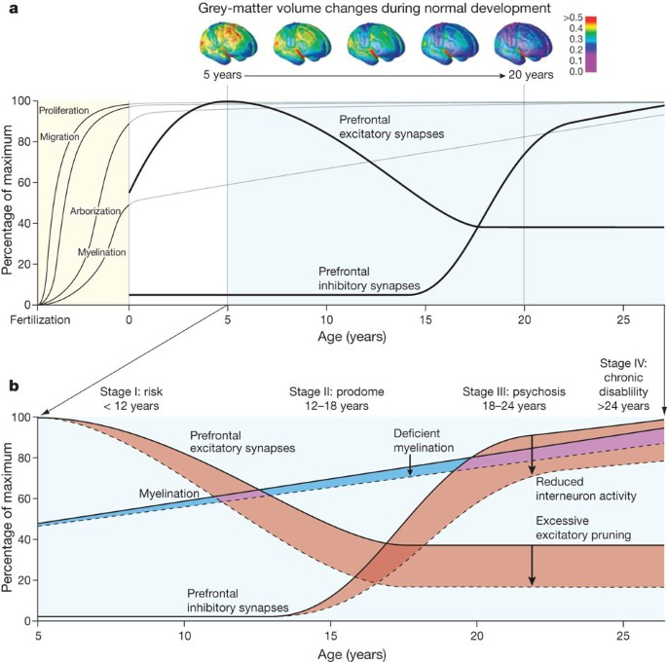
Early Stage Detection
Social Anxiety
Mercury is the closest planet to the Sun
Venus has a beautiful name, but is hot
Despite being red, Mars is cold
Saturn
Neptune
Saturn is a gas giant with several rings
Neptune is the farthest planet from the Sun
Notes:
Just in case things go wrong that why ml for schizophrenia so keep this as an extra slide not in the 10 main slides

Slide 27
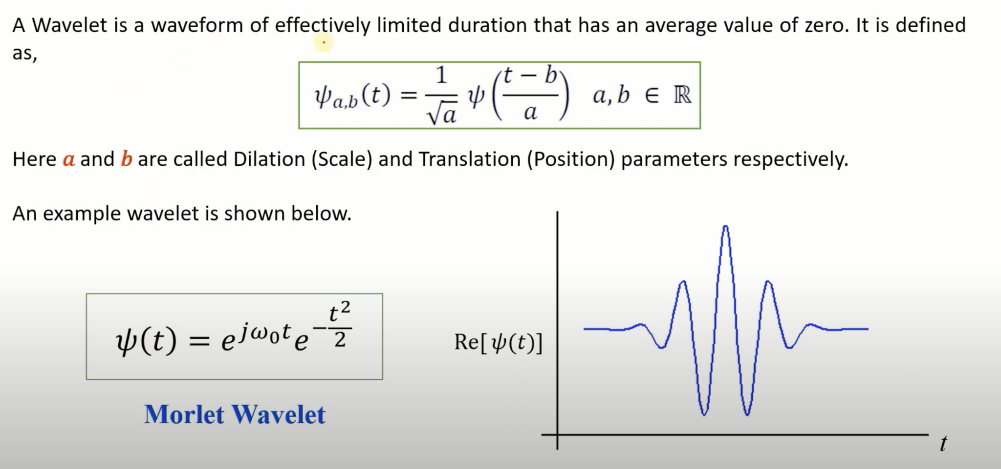

Slide 28
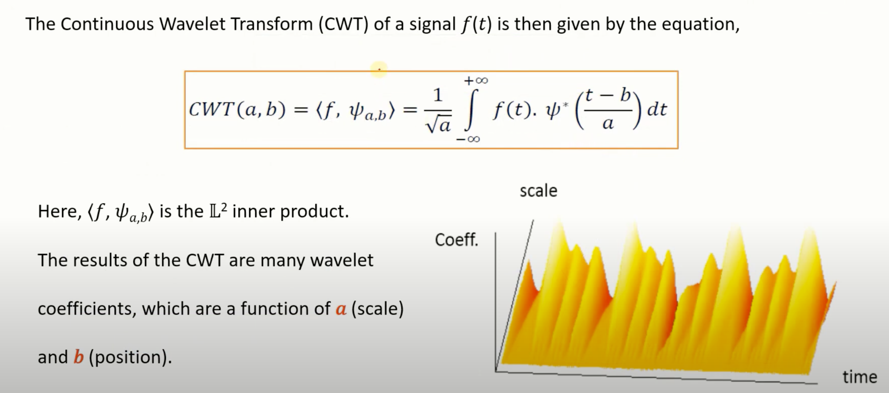

Slide 29
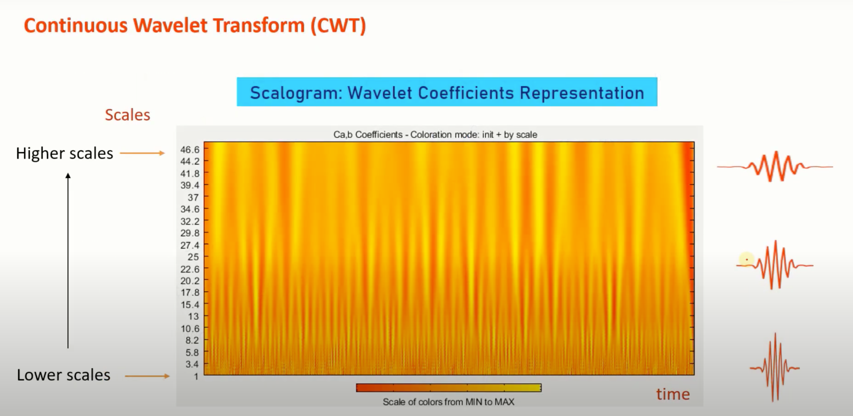

Slide 30
